Slide 1
BIG DATA
WELCOME
TO

Slide 2
Apache NIfi
Allows you to do data ingestion to pull data into NiFi, from numerous data sources
It offers real-time control which helps you to manage the movement of data between any source & destination

Slide 3
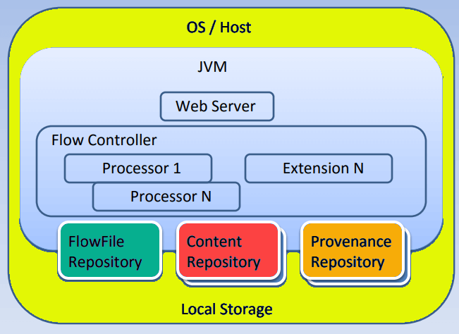
NiFi architecture
FlowFile
Original data
Connection
Linkage between processors
Processor
Java module, responsible for fetching and storing data
Flow controller
Record of how processes are connected

Slide 4
NiFi architecture
Content Repository
Contains FlowFiles
Flowfile Repository
Repository that store metadata of each of the FlowFiles
Provenance Repository
Check the information about a FlowFiles and helps in troubleshooting FlowFiles.

Slide 5
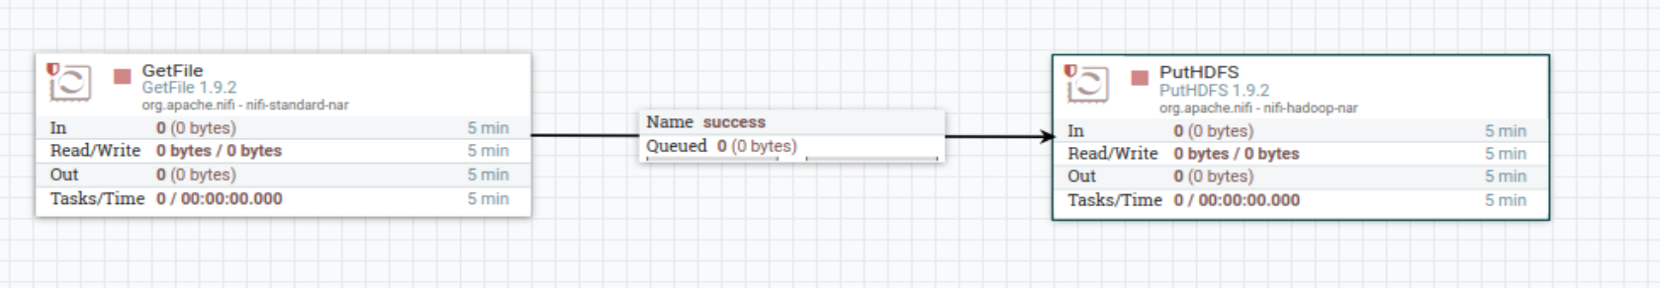
Nifi DatAFLOW

